Slide 1
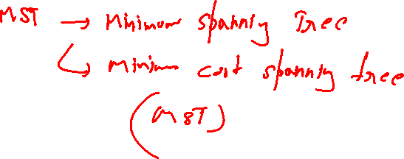
Designing and Analysis of Algorithms Course Code: ECS 5101/CS514
Dr Rahul Mishra
IIT Patna
Lecture 23

Slide 2
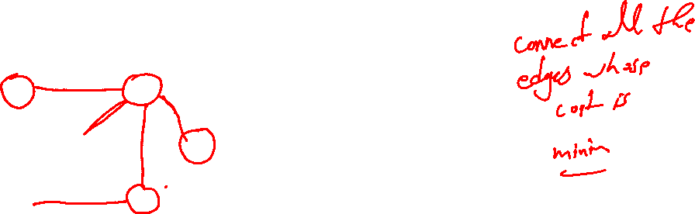
Minimum-cost spanning trees
Suppose you have a connected undirected graph with a weight (or cost) associated with each edge
The cost of a spanning tree would be the sum of the costs of its edges
A minimum-cost spanning tree is a spanning tree that has the lowest cost
16
16
A
B
A
B
21
11
6
11
6
19
5
5
F
C
F
C
33
14
10
E
18
D
E
18
D
A connected, undirected graph
A minimum-cost spanning tree

Slide 3
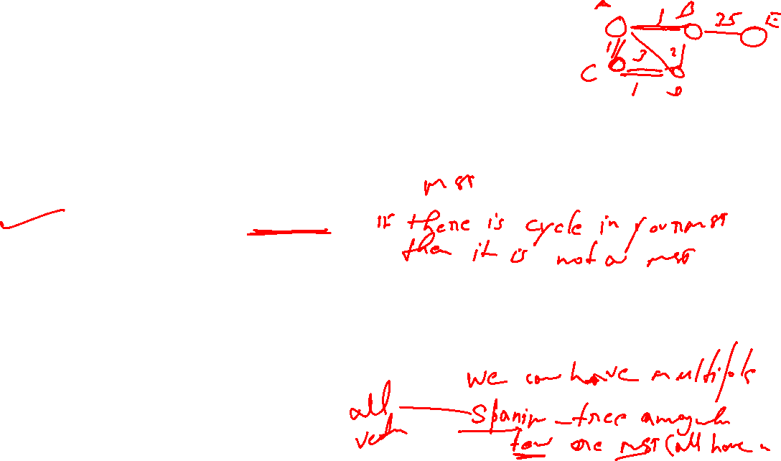
Minimum Spanning Tree (MST)
A minimum spanning tree is a subgraph of an undirected weighted graph G, such that
it is a tree (i.e., it is acyclic)
it covers all the vertices V
contains |V| - 1 edges
the total cost associated with tree edges is the minimum among all possible spanning trees
not necessarily unique

Slide 4
Applications of MST
Any time you want to visit all vertices in a graph at minimum cost (e.g., wire routing on printed circuit boards, sewer pipe layout, road planning…)
Internet content distribution
Idea: publisher produces web pages, content distribution network replicates web pages to many locations so consumers can access at higher speed
MST may not be good enough!
content distribution on minimum cost tree may take a long time!
Provides a heuristic for traveling salesman problems. The optimum traveling salesman tour is at most twice the length of the minimum spanning tree (why??)

Slide 5
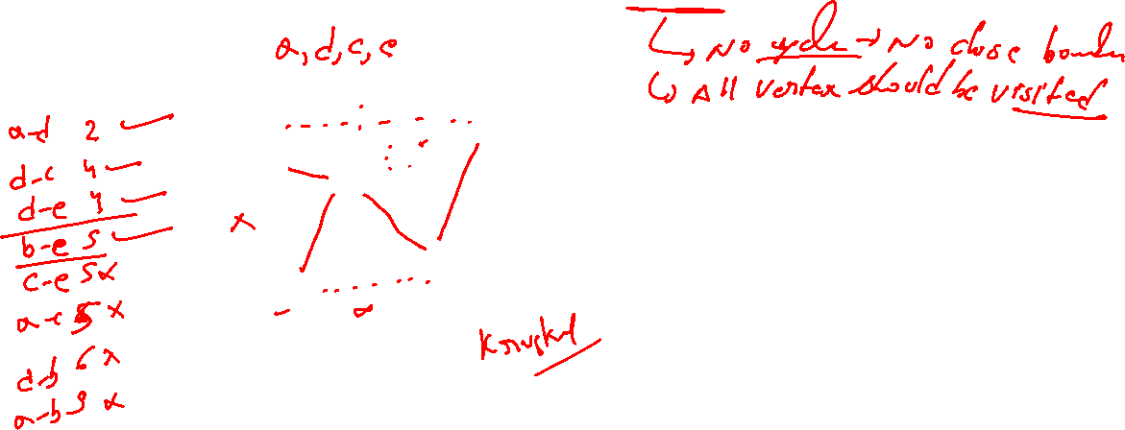
How Can We Generate a MST?
9
b
9
b
a
2
6
a
2
6
d
d
4
5
4
5
5
4
5
4
5
e
5
e
c
c

Slide 6
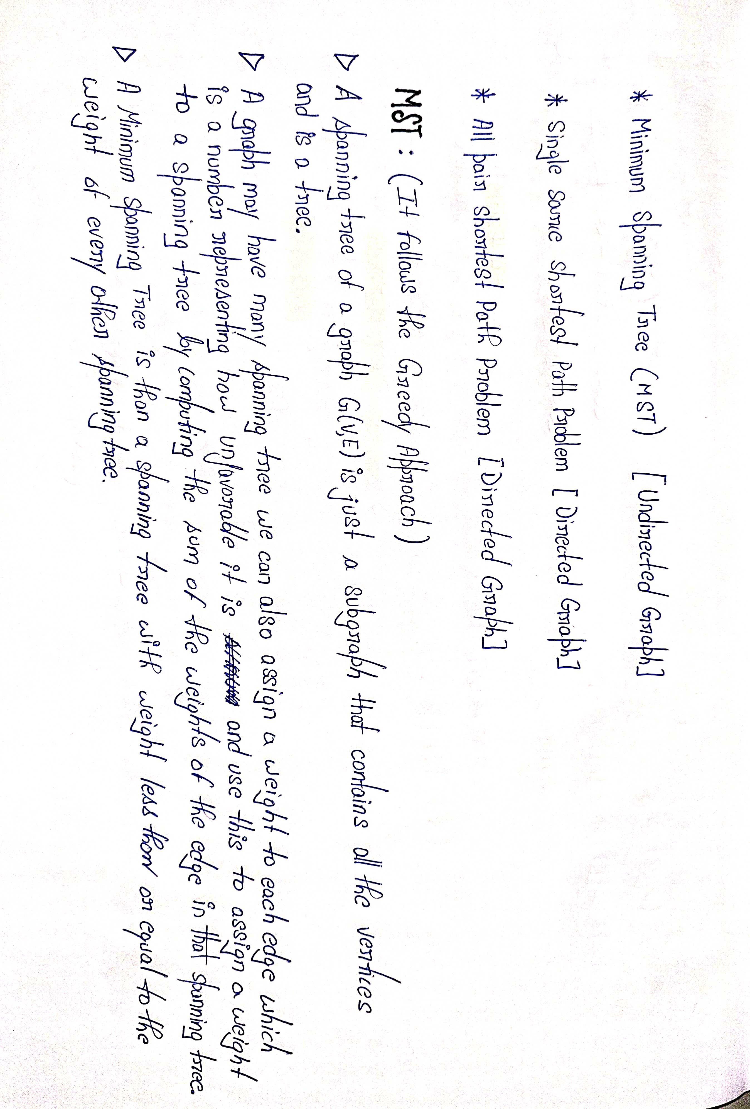
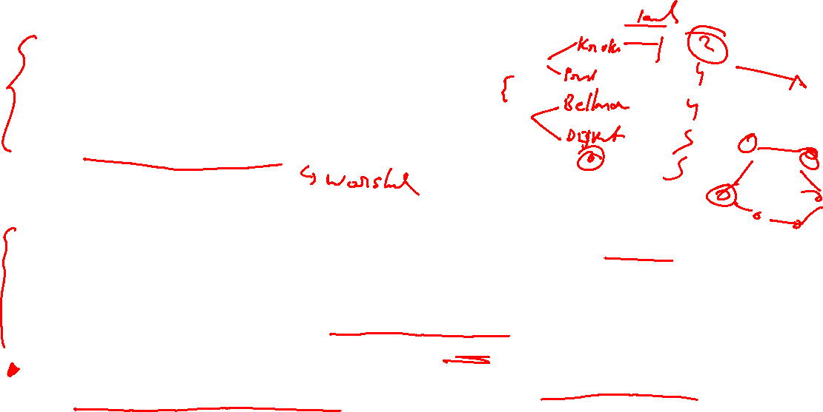

Slide 7
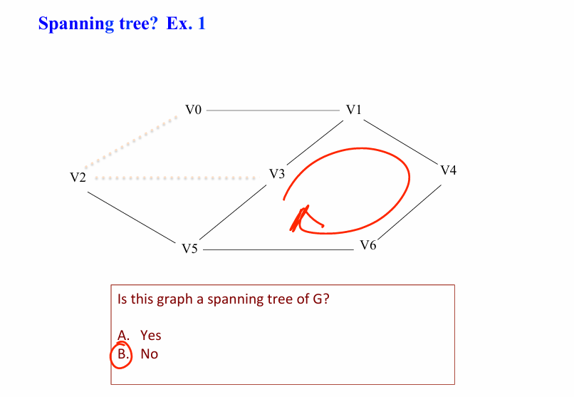
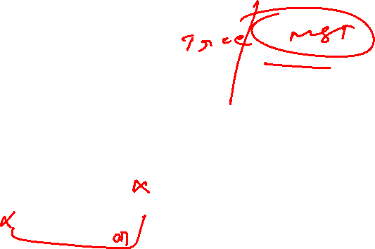

Slide 8
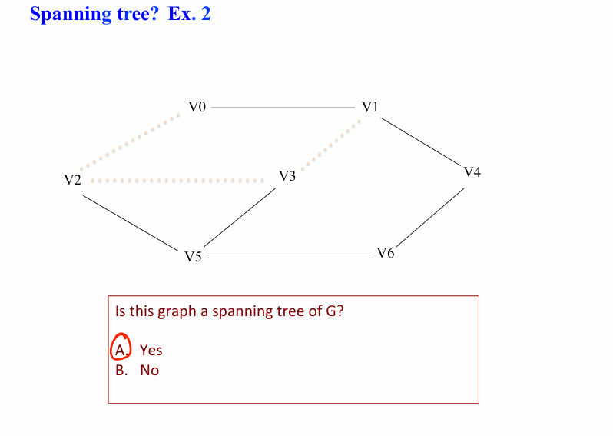
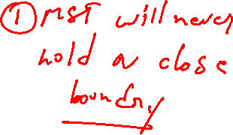

Slide 9
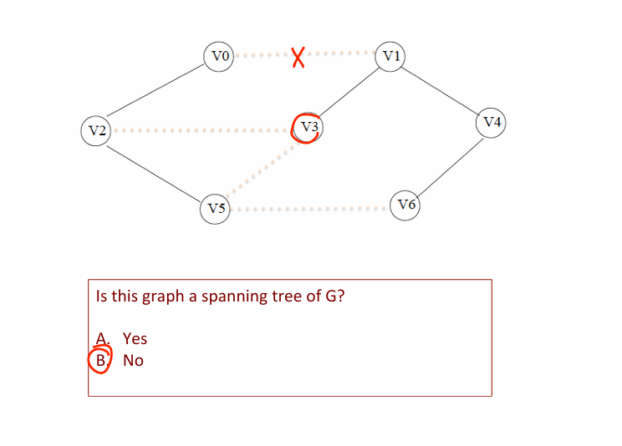
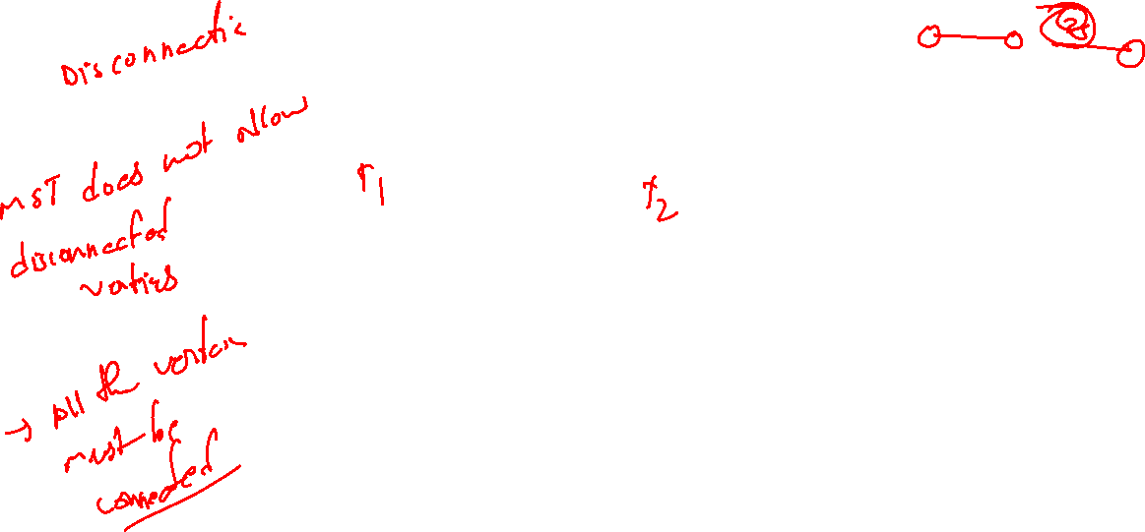

Slide 10
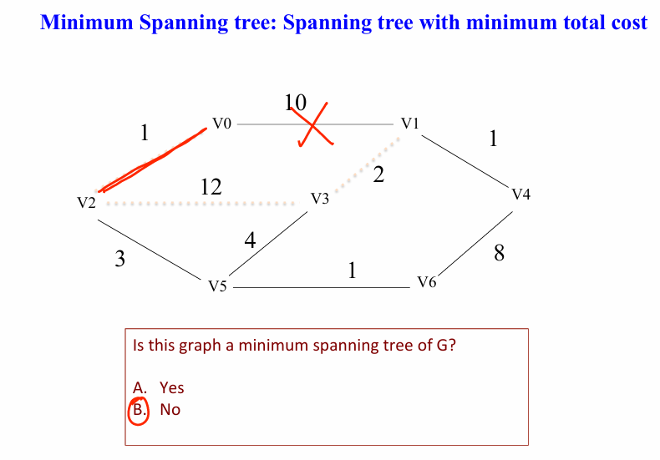
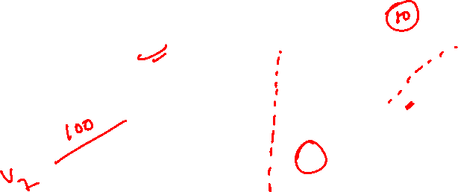
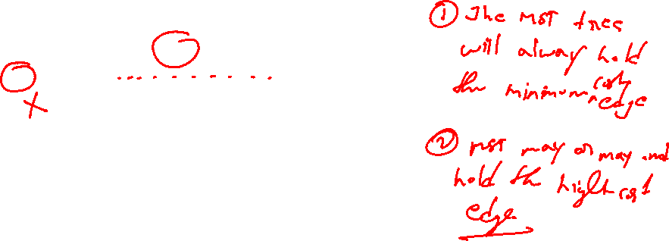

Slide 11
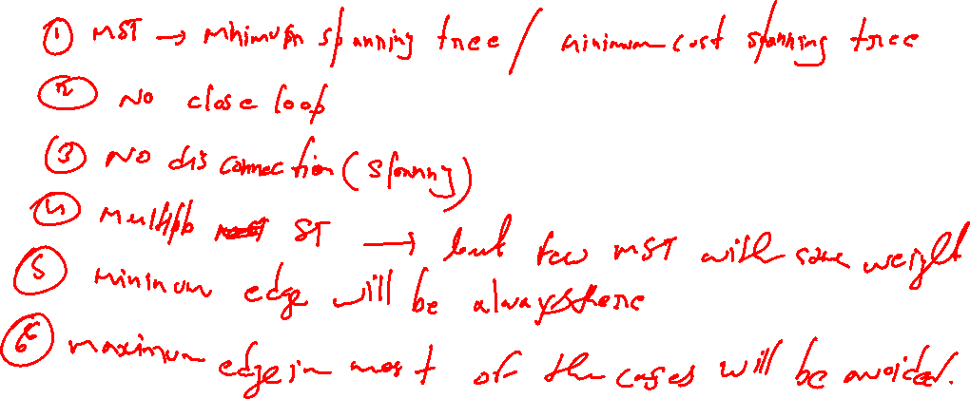

Slide 12
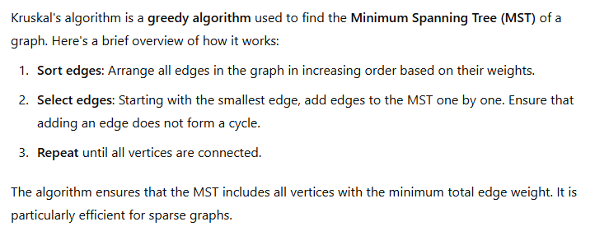
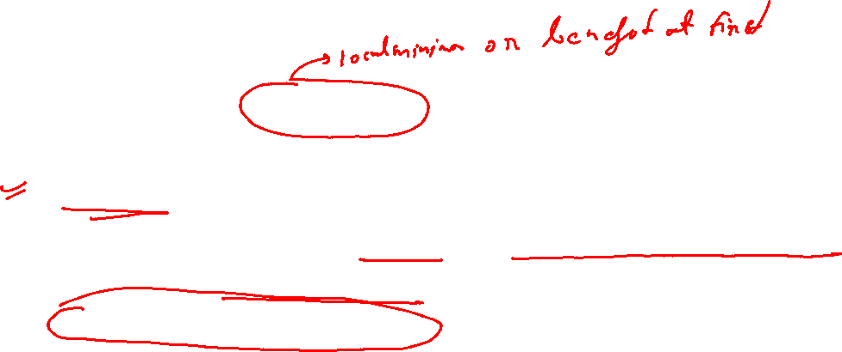

Slide 13
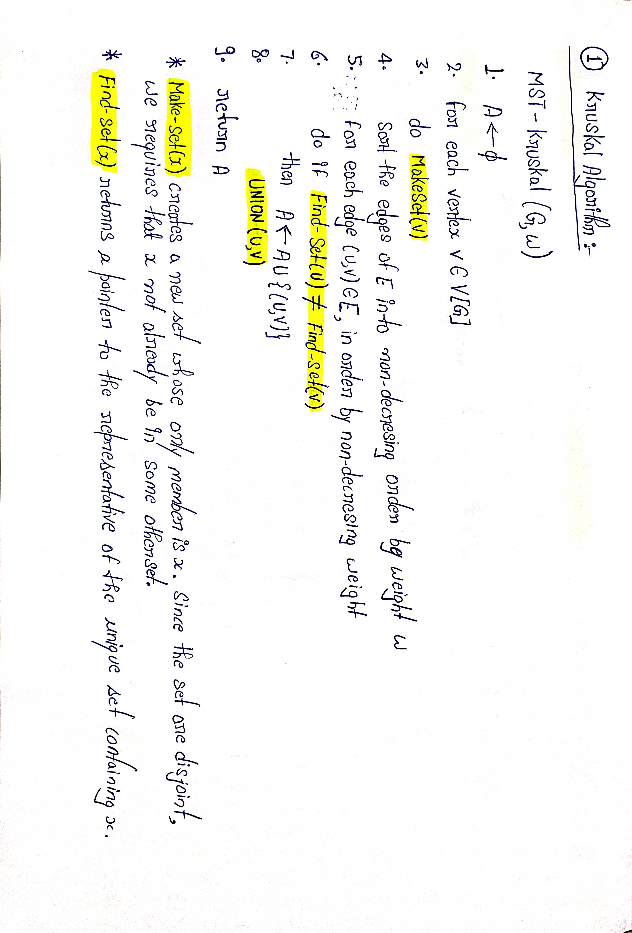
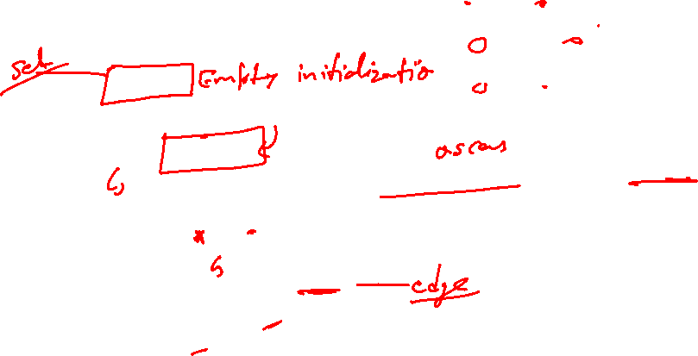
#Avoid cycle
#Both have same parent

Slide 14
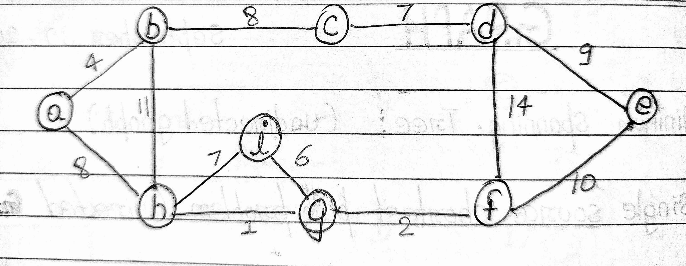
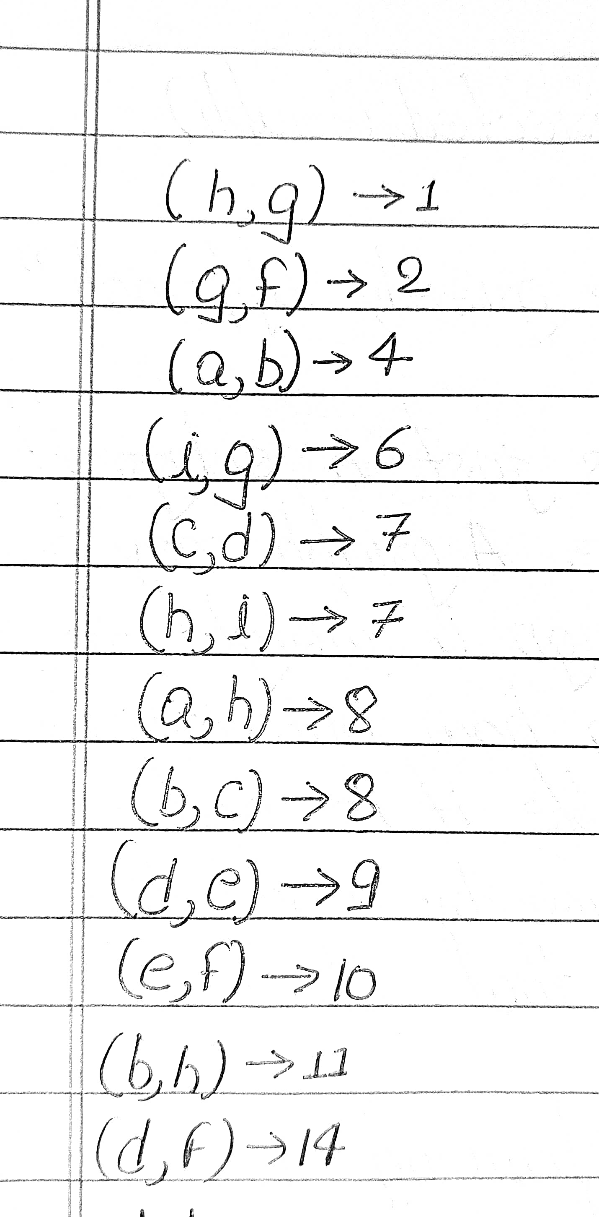
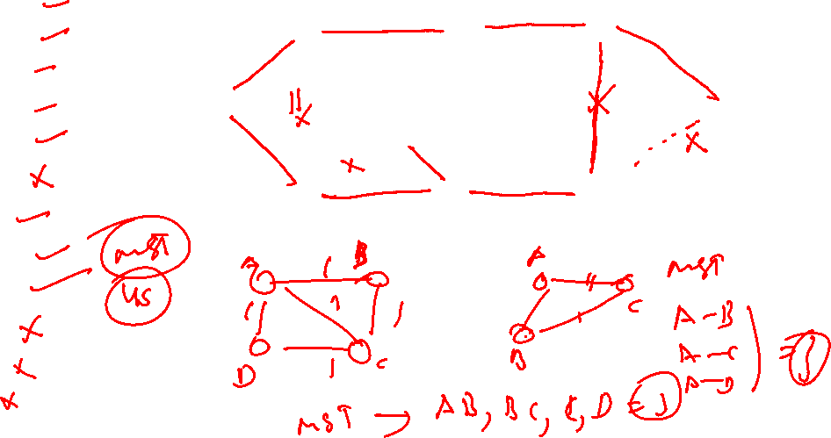

Slide 15
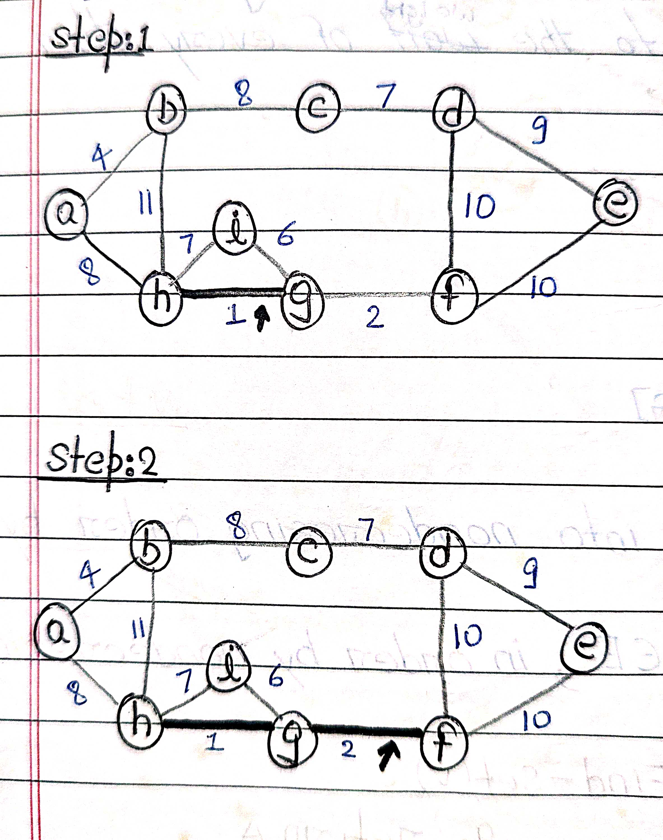
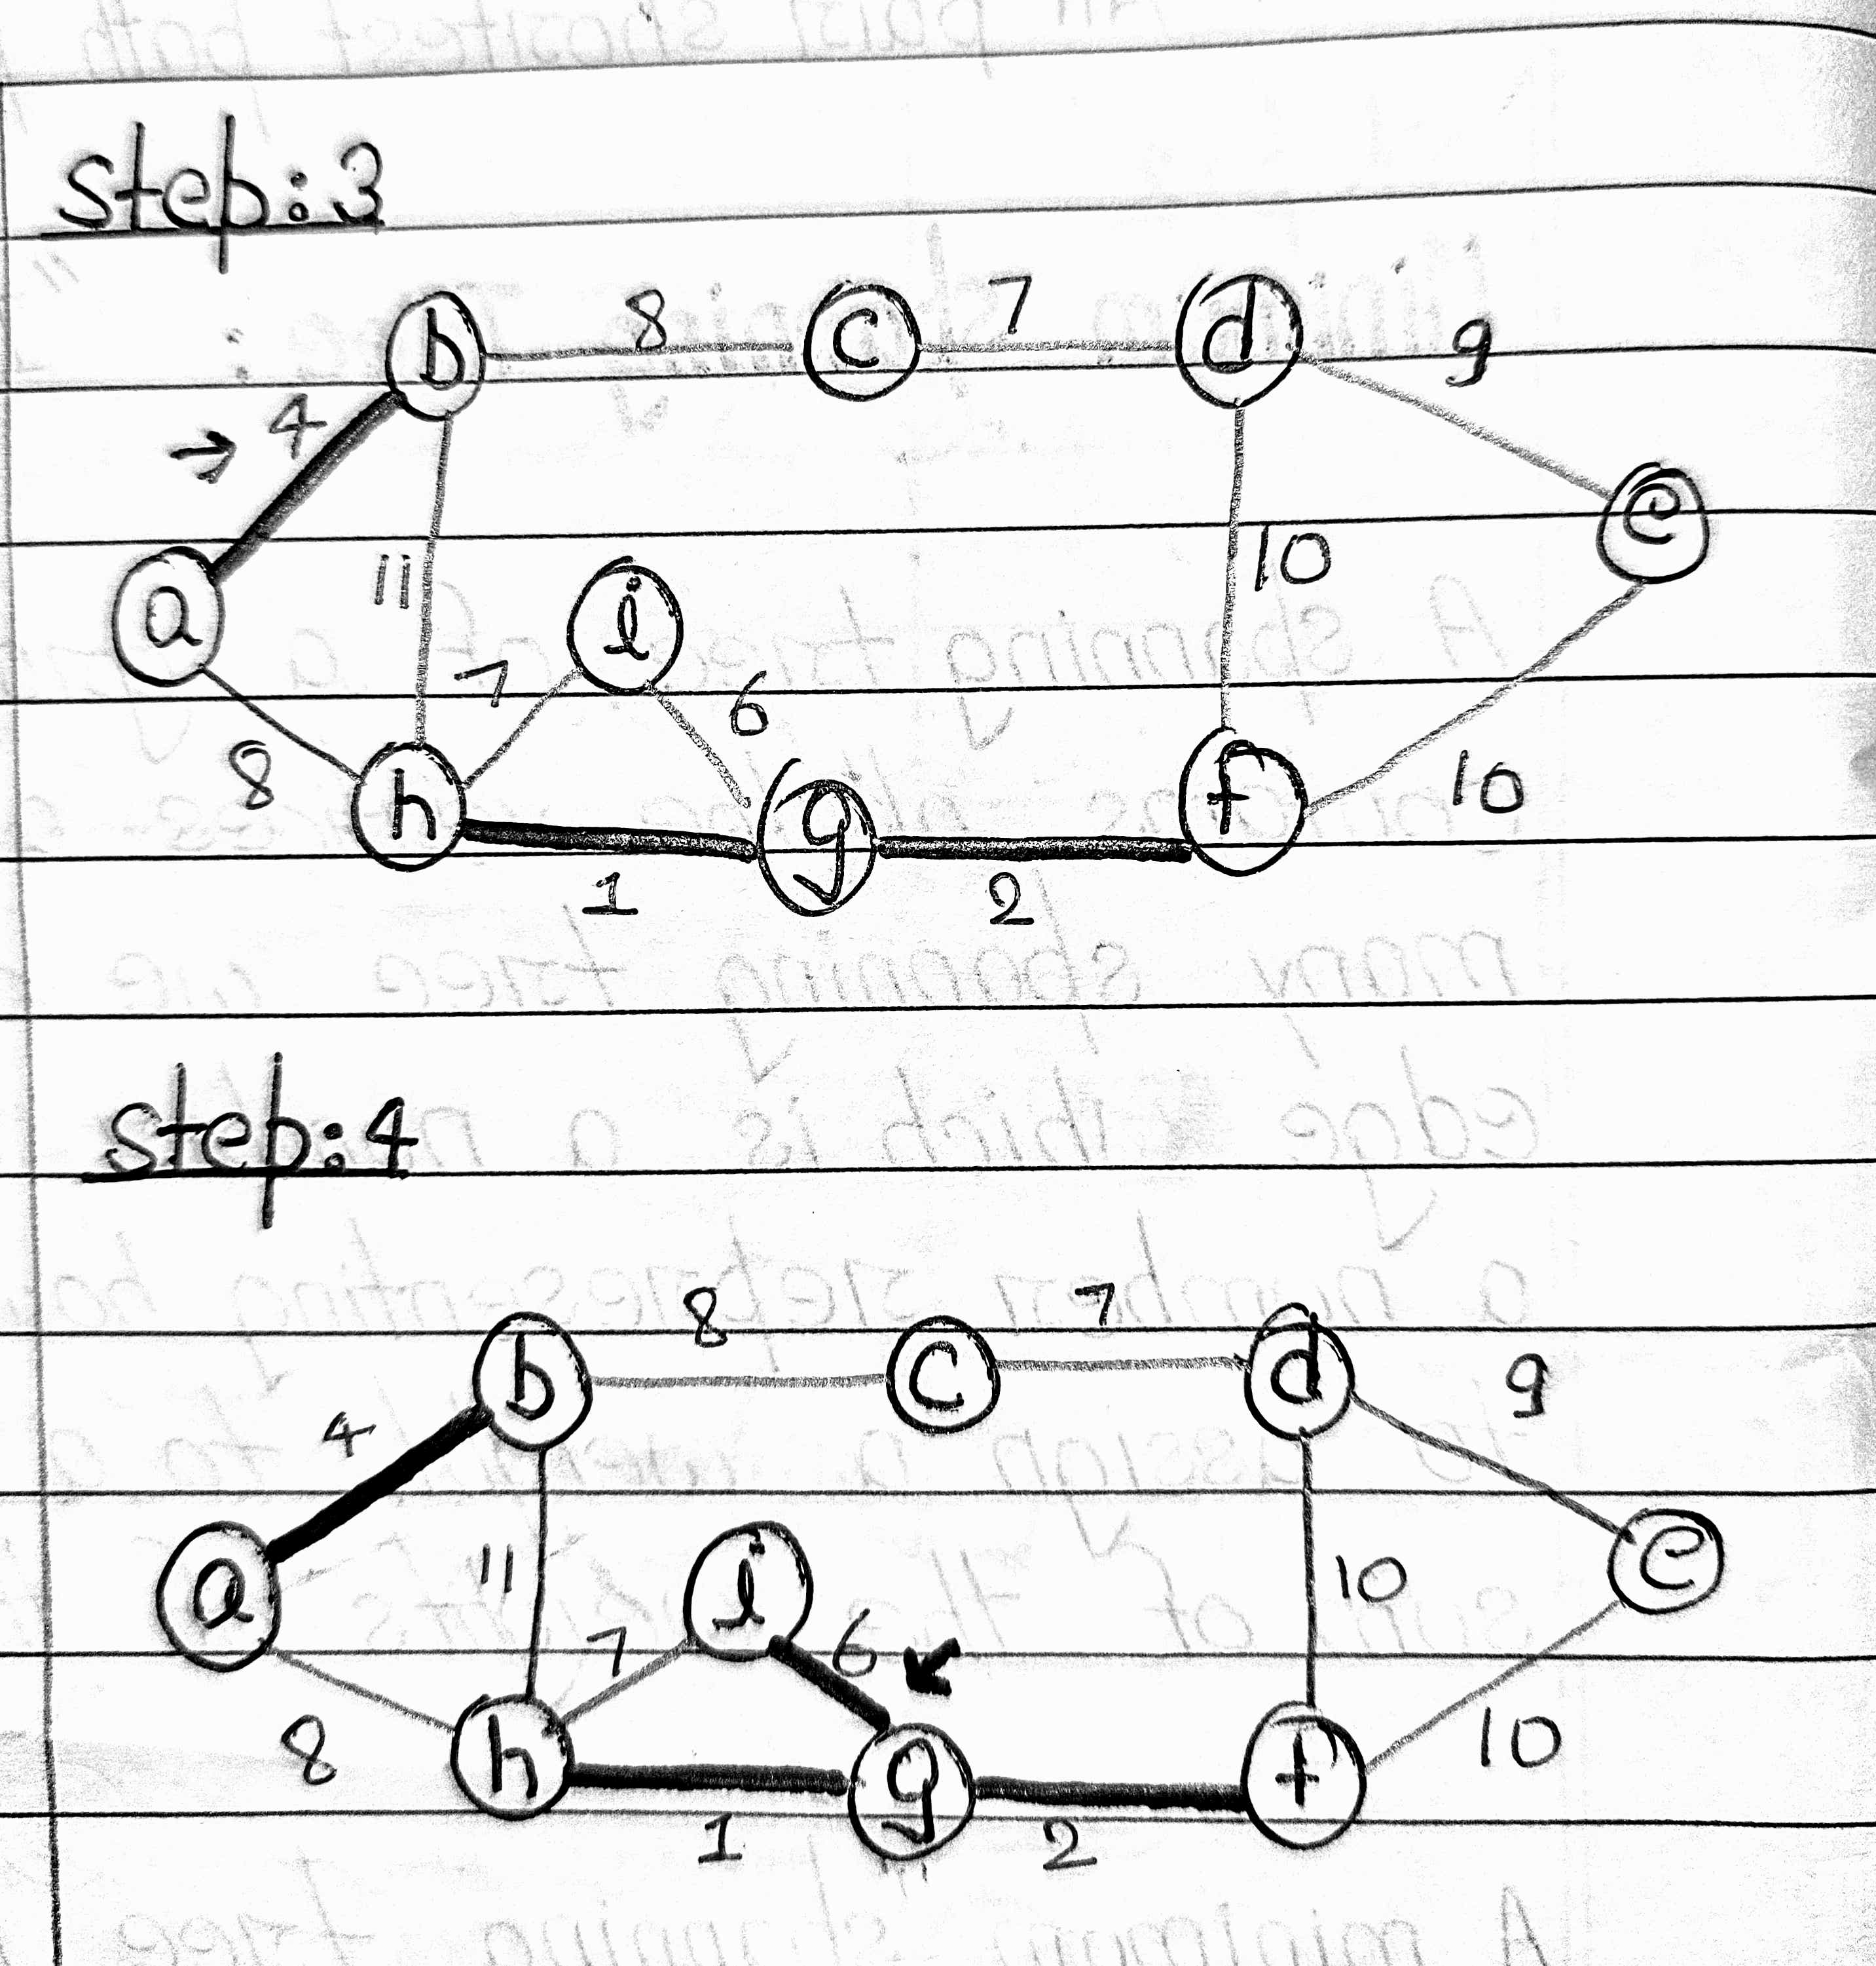

Slide 16
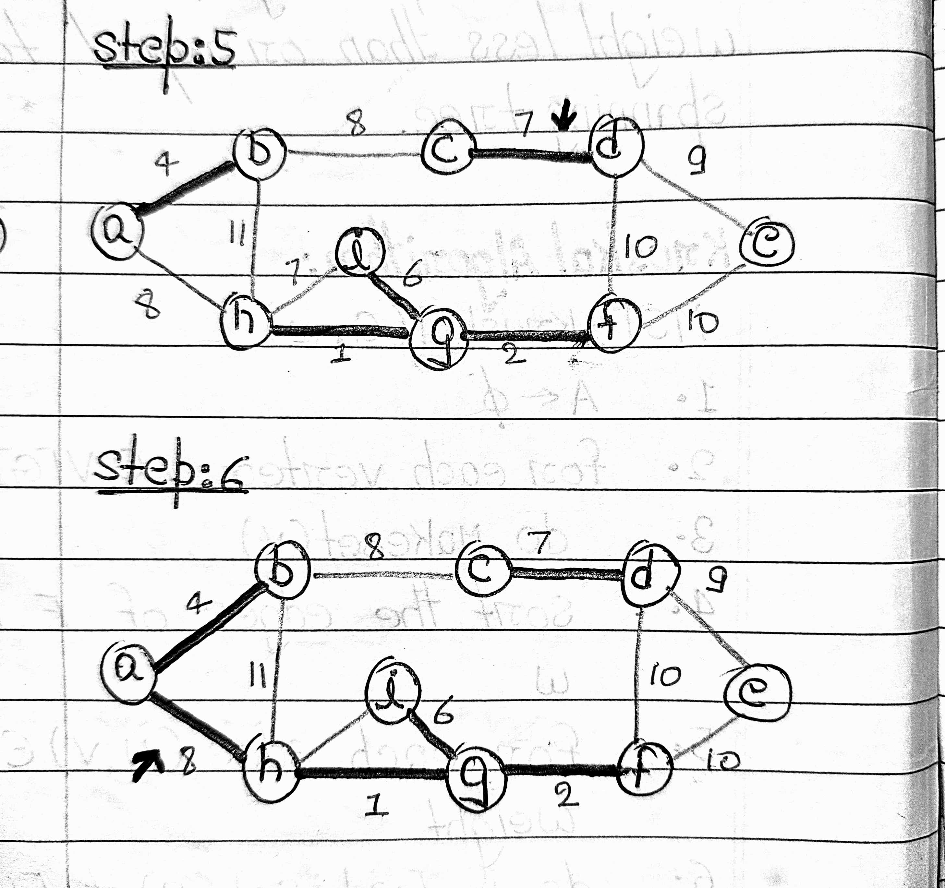
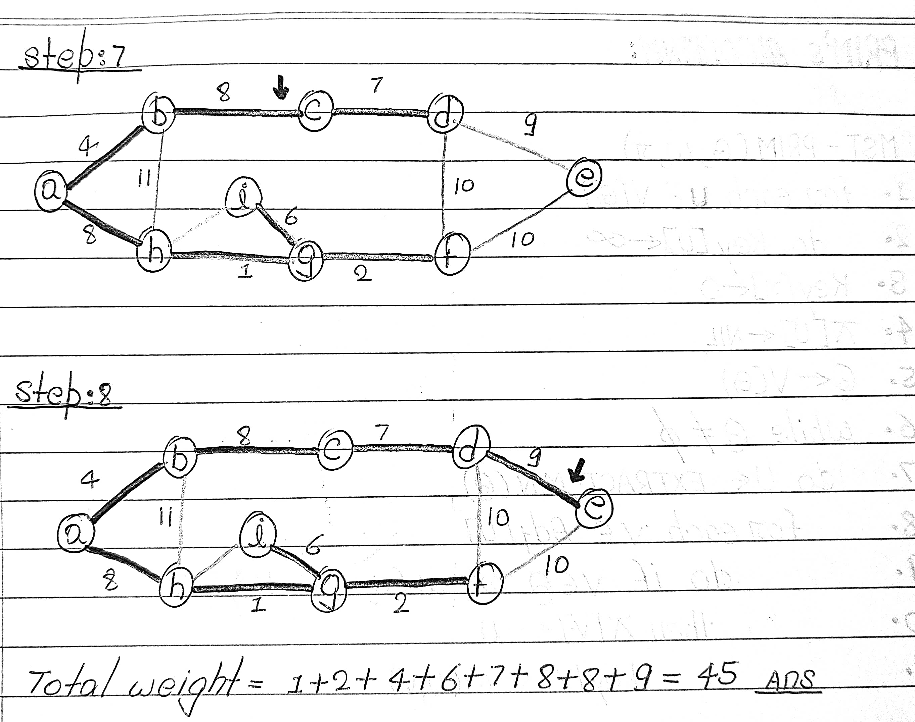

Slide 17
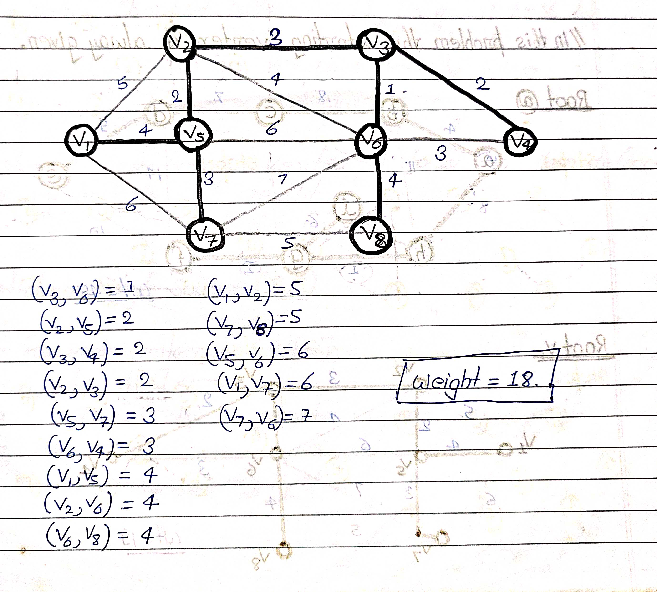





Slide 18
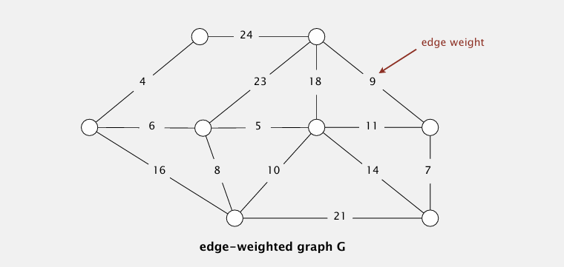
Class Assignment

Slide 19
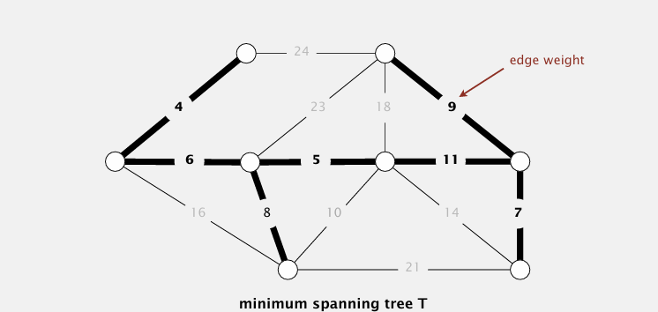

Slide 20
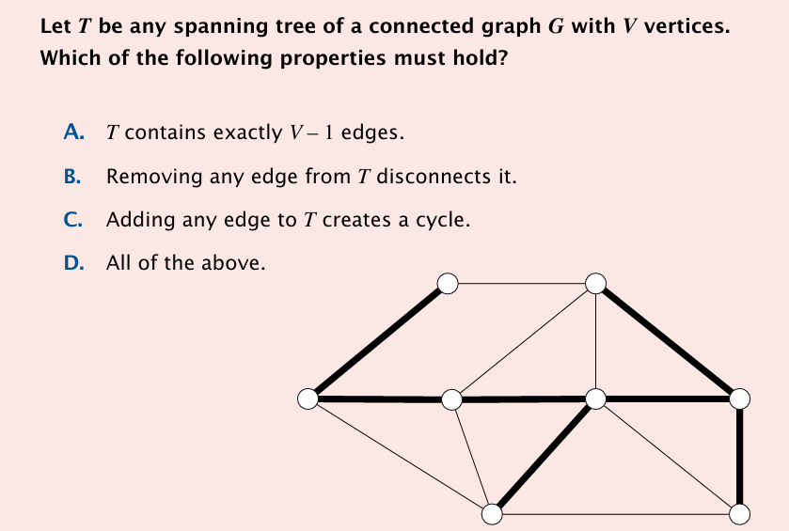

Slide 21
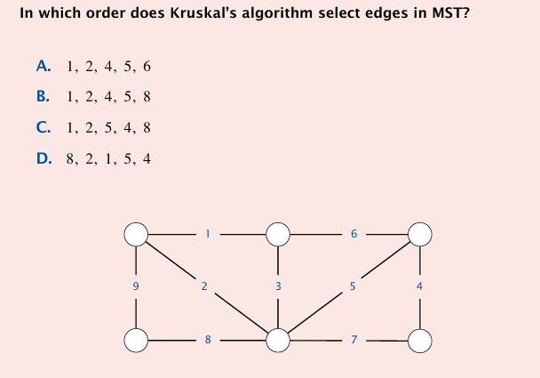

Slide 22
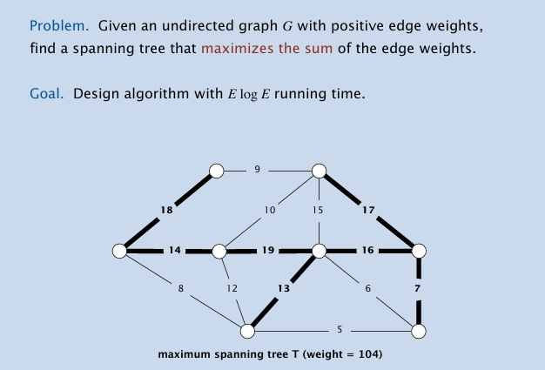

Slide 23
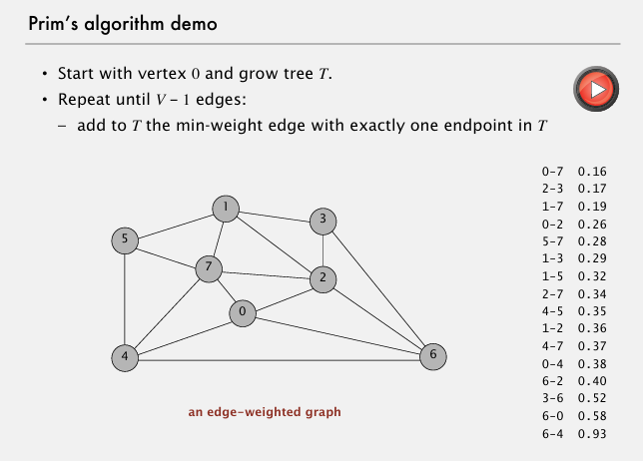

Slide 24
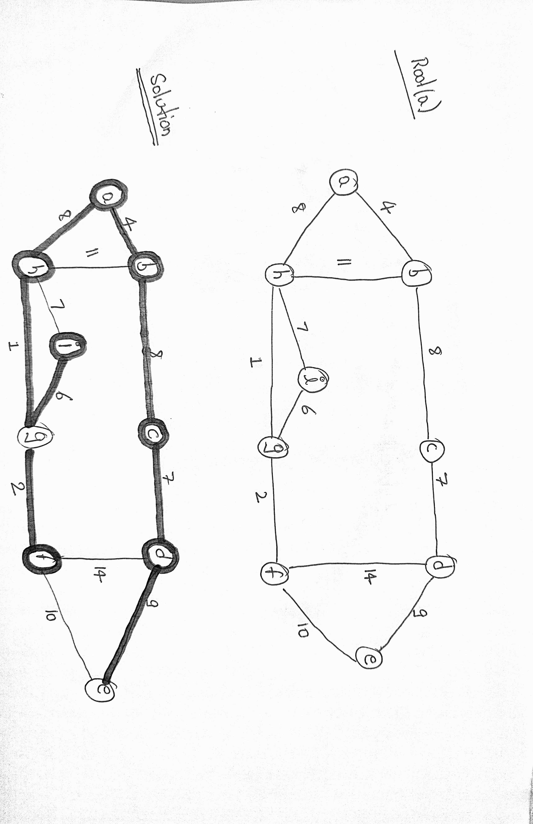

Slide 25
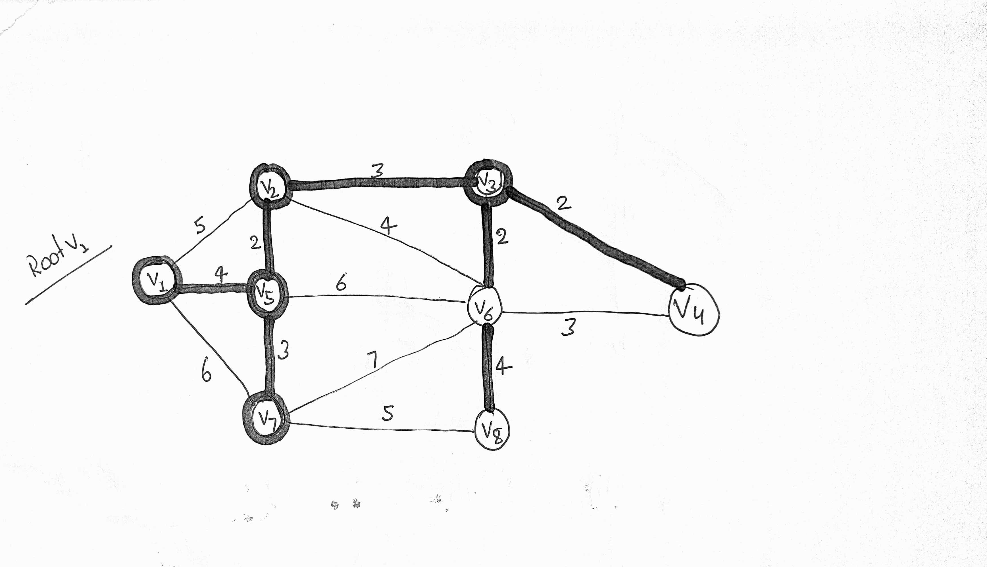

Slide 26
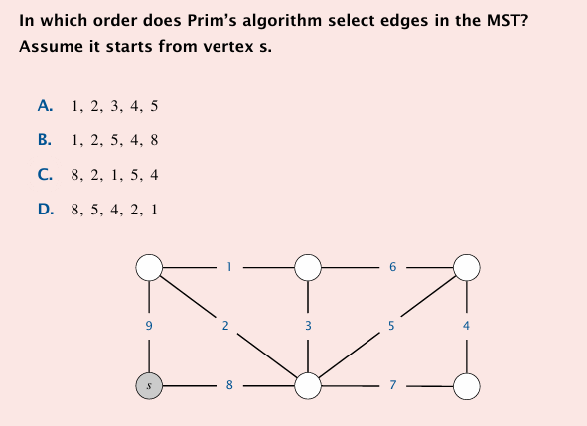

Slide 27
